Slide 1

Capstone Project
Bike Sharing Demand Prediction
Team Members Debashish Das Lucky Jain Vivek Katolkar

Slide 2
CONTENT
❏ BUSINESS UNDERSTANDING
❏ DATA SUMMARY
❏ FEATURE ANALYSIS
❏ EXPLORATORY DATA ANALYSIS
❏ DATA PREPROCESSING
❏ IMPLEMENTING ALGORITHMS
❏ CHALLENGES
❏ CONCLUSIONS

Slide 3
BUSINESS UNDERSTANDING
➢ Bike rentals have became a popular service in recent years and it seems people are using it more often. With relatively cheaper rates and ease of pick up and drop at own convenience is what making this business thrive.
➢ Mostly used by people having no personal vehicles and also to avoid congested public transport which that’s why they prefer rental bikes.
➢ Therefore, the business to strive and profit more, it has to be always ready and supply no. of bikes at different locations, to fulfill the demand.
➢ Our project goal is a pre-planned set of bike count values that can be a handy solution to meet all demands.

Slide 4
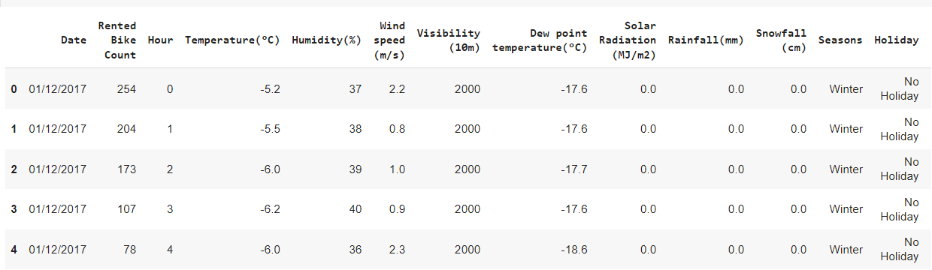
DATA SUMMARY
➢ This Dataset contains 8760 lines and 14 columns.
➢ Three categorical features ‘Seasons’, ‘Holiday’, & ‘Functioning Day’.
➢ One Date-time features ‘Date’.
➢ We have some numerical type variables such as temperature, humidity, wind, visibility, dew point temp, solar radiation, rainfall, snowfall which tells the environment conditions at that particular hour of the day.

Slide 5
FEATURE SUMMARY
➢ Date : Year-Month-Day
➢ Rented Bike Count - Count of bikes rented at each hour
➢ Hour - Hour of the day
➢ Temperature - Temperature in Celsius
➢ Humidity - %
➢ Wind Speed - m/s
➢ Visibility - 10m
➢ Dew point temperature –Celsius
➢ Solar radiation -MJ/m2
➢ Rainfall -mm
➢ Snowfall -cm
➢ Seasons -Winter, Spring, Summer, Autumn
➢ Holiday -Holiday/No Holiday
➢ Functional Day – No-Func(Non Functional Hrs),Fun(Functional Hrs)

Slide 6
INSIGHTS FROM OUR DATASET
➢ There are No Missing Values present.
➢ There are No Duplicate values present.
➢ There are No null values.
➢ And finally we have 'rented bike count' variable which we need to predict for new observations.
➢ The dataset shows hourly rental data for one year (1 December 2017 to 31 November(2018)(365 days).we consider this as a single year data.
➢ So we convert the "date" column into 3 different column i.e. "year", "month", "day".
➢ We change the name of some features for our convenience , they are as below 'Rented_Bike_Count', 'Hour', 'Temperature', 'Humidity', 'Wind_speed', 'Visibility', ‘Dew_point_temperature', 'Solar_Radiation', 'Rainfall', 'Snowfall', 'Seasons', 'Holiday', 'Functioning_Day', 'month','weekdays_weekend'

Slide 7
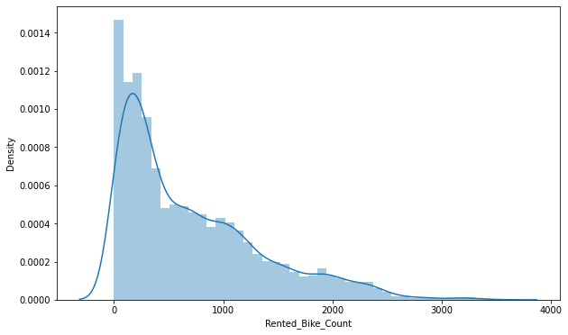
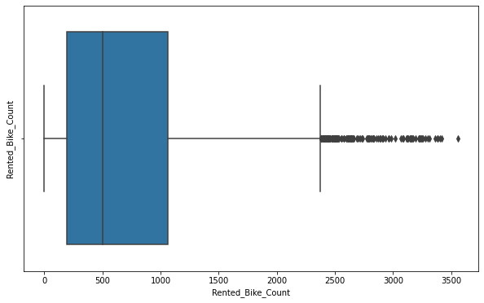
ANALYSIS OF RENTED BIKE COLUMN
➢ The above graph shows that Rented Bike Count has moderate right skewness.
➢ The above boxplot shows that we have detect outliers in Rented Bike Count column.
➢ Since the assumption of linear regression is that 'the distribution of dependent variable has to be normal', so we should perform Square root operation to make it normal

Slide 8
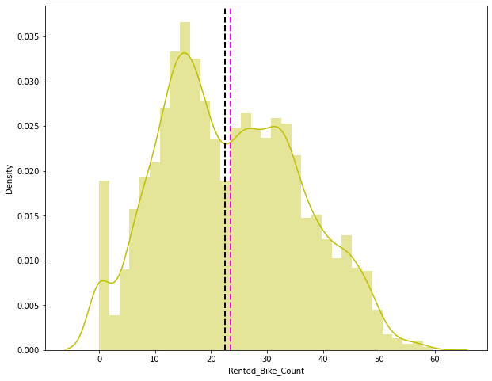
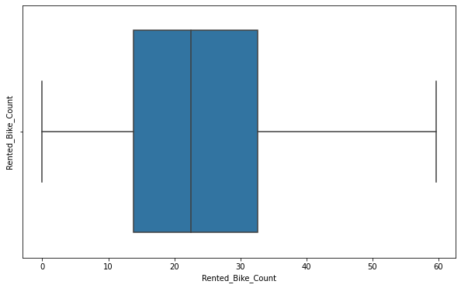
ANALYSIS OF RENTED BIKE COLUMN
➢ After applying Square root to the skewed Rented Bike Count, here we get almost normal distribution.
➢ After applying Square root to the Rented Bike Count column, we find that there is no outliers present

Slide 9
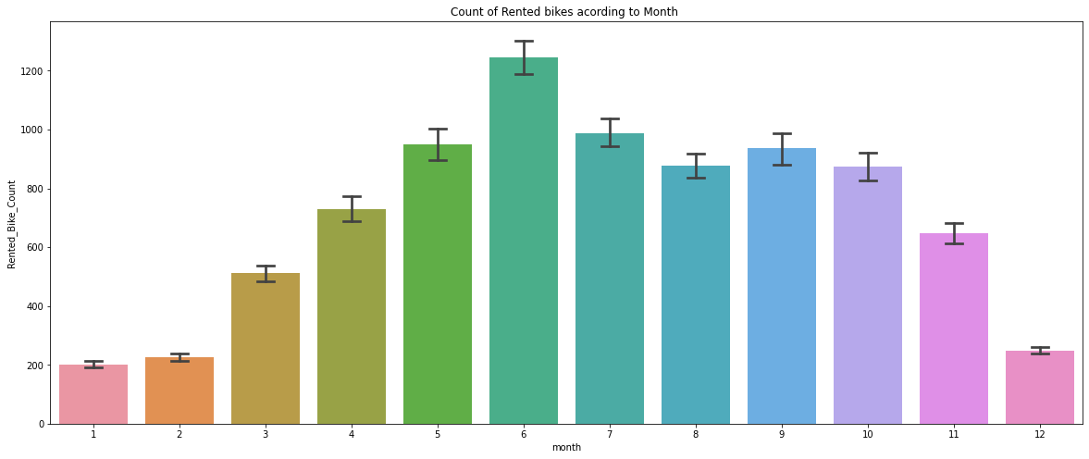
ANALYSIS OF MONTH VARIABLE
➢ From the above bar plot we can clearly say that from the month 5 to 10 the demand of the rented bike is high as compare to other months. these months comes inside the summer season.

Slide 10
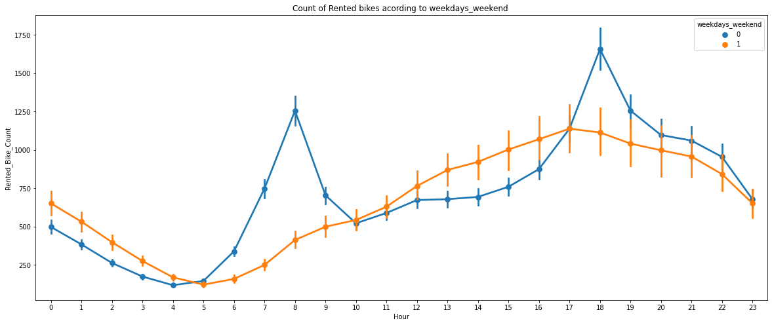
ANALYSIS OF WEEKDAYS_WEEKEND VARIABLE
● From the above point plot and bar plot we can say that in the weekdays which represent in blue colour show that the demand of the bike higher because of the office.
● Peak Time are 7 am to 9 am and 5 pm to 7 pm.
● The orange color represent the weekend days, and it show that the demand of rented bikes are very low especially in the morning hour but when the evening start from 4 pm to 8 pm the demand slightly increases.

Slide 11
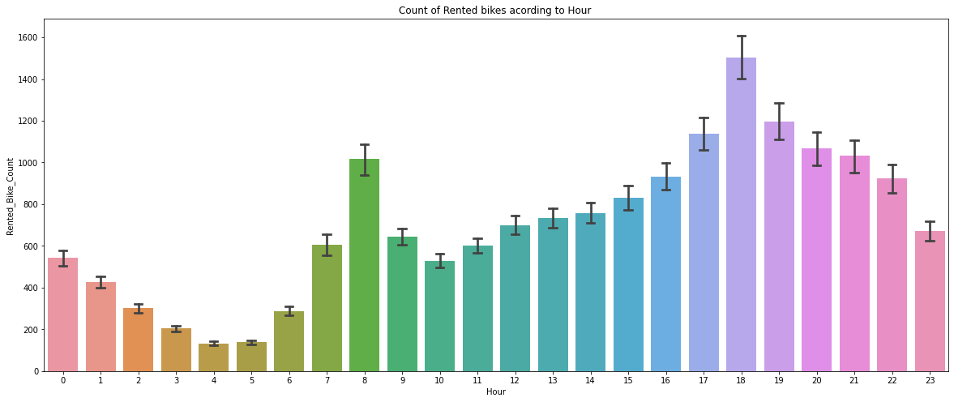
ANALYSIS OF HOUR VARIABLE
➢ In the above plot which shows the use of rented bike according the hours and the data are from all over the year.
➢ Generally people use rented bikes during their working hour from 7am to 9am and 5pm to 7pm.

Slide 12
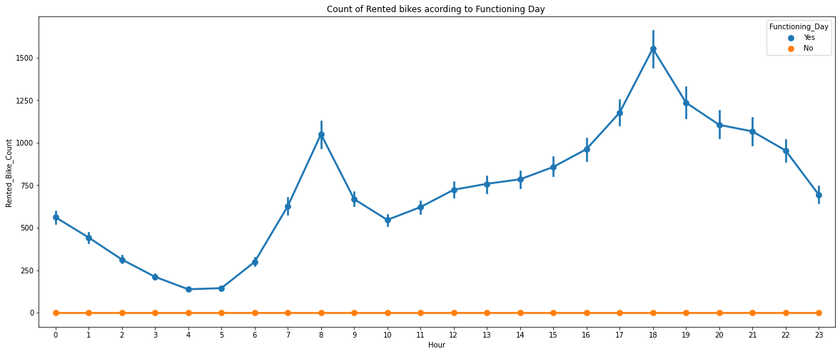
ANALYSIS OF FUNCTIONING DAY VARIABLE
➢ In the above point plot ,it shows the use of rented bike in functioning day or not.
➢ Peoples don’t use rented bikes in no functioning day.

Slide 13
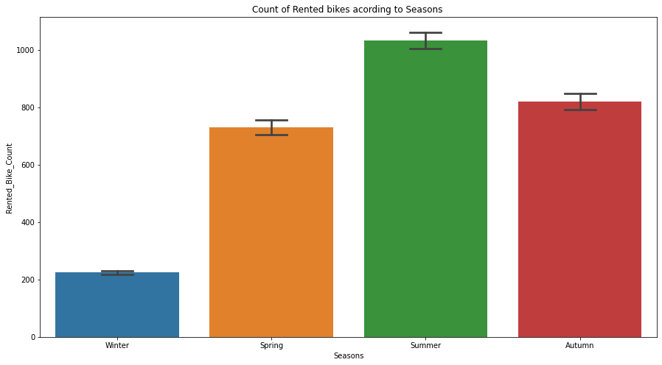
ANALYSIS OF SEASON VARIABLE
➢ This above bar plot shows the distribution of rented bike count season wise.
➢ And we can clearly see that that peoples love to ride bike in summer seasons and autumn season.
➢ But in winter season people don't take any rented bike because of snowfall.

Slide 14
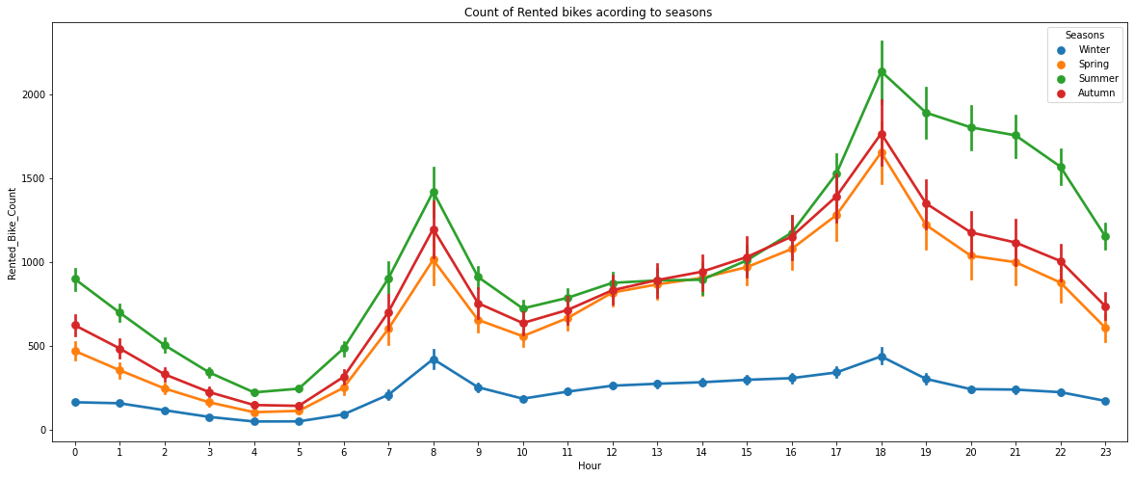
ANALYSIS OF SEASON VARIABLE
➢ In the above bar plot and point plot which shows the use of rented bike in in four different seasons, and it clearly shows in the graph.
➢ In summer season the use of rented bike is high and peak time is 7am-9am and 7pm-5pm.
➢ In winter season the use of rented bike is very low because of snowfall.

Slide 15
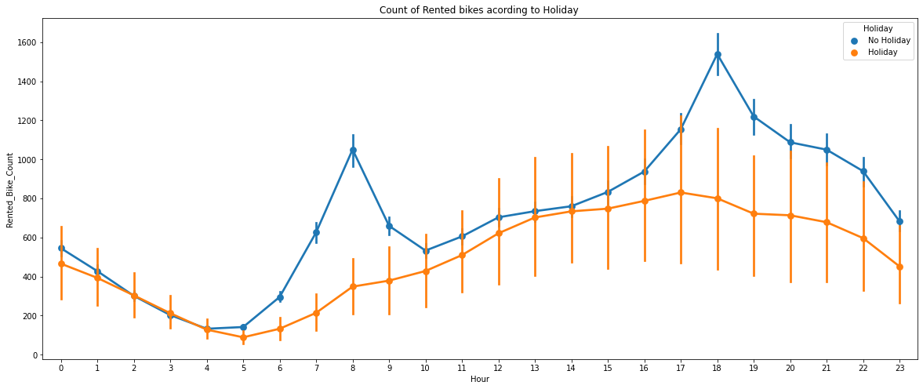
ANALYSIS OF HOLIDAY VARIABLE
➢ In the above bar plot and point plot which shows the use of rented bike in a holiday, and it clearly shows that, in holiday, people use the rented bike from 2pm - 8pm

Slide 16
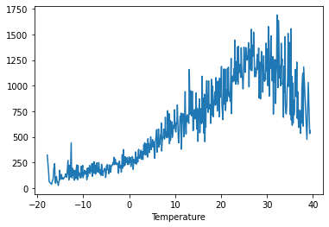
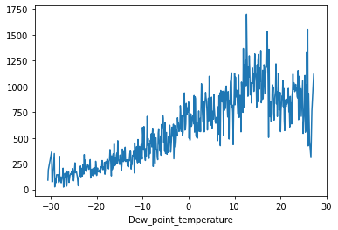
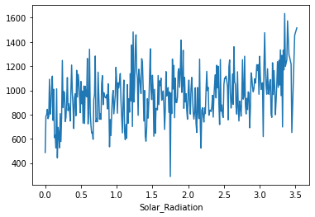
NUMERICAL V/S RENTED BIKE COUNT
➢ From the above plot we see that people like to ride bikes when it is pretty hot around 25°C in average.
➢ From the above plot of "Dew_point_temperature' is almost same as the 'temperature' there is some similarity present we can check it in our next step.
➢ From the above plot we see that, the amount of rented bikes is huge, when there is solar radiation, the counter of rents is around 1000.

Slide 17
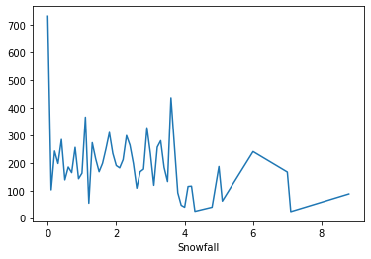
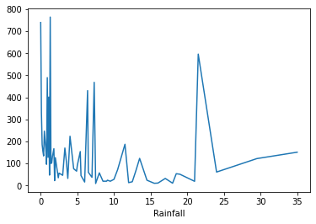
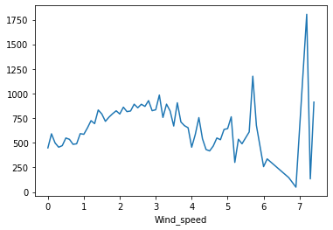
NUMERICAL V/S RENTED BIKE COUNT
● In snowfall plot, on the y-axis, the amount of rented bike is very low When we have more than 4 cm of snow, the bike rents is much lower.
● In rainfall plot if it rains a lot the demand of of rent bikes is not decreasing, here for example even if we have 20 mm of rain there is a big peak of rented bikes.
● In wind speed plot that the demand of rented bike is uniformly distribute despite of wind speed. but when the speed of wind was 7 m/s then the demand of bike also increase that clearly means peoples love to ride bikes when its little windy.

Slide 18
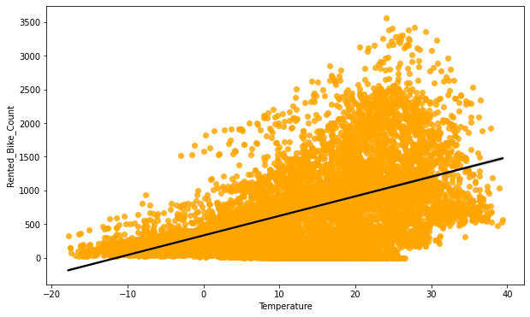
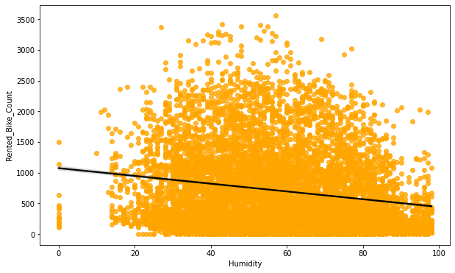
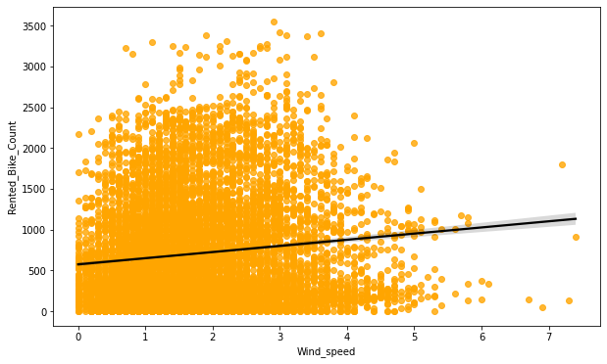
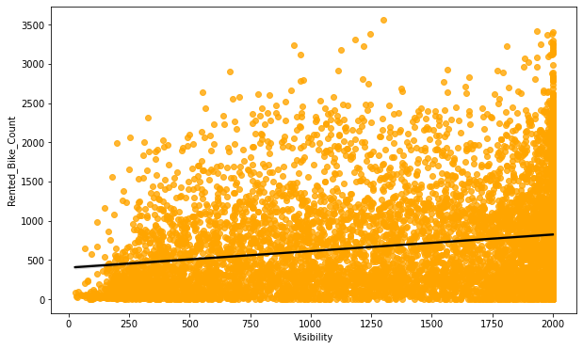
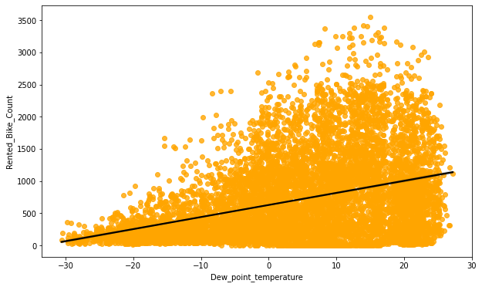
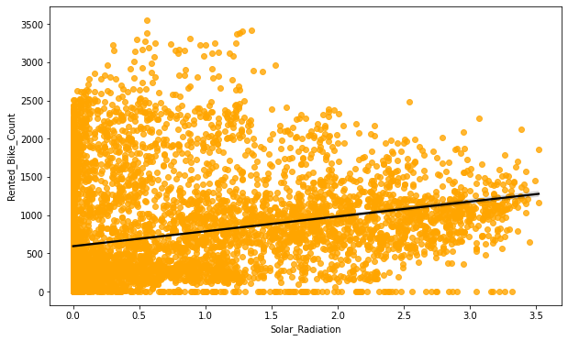
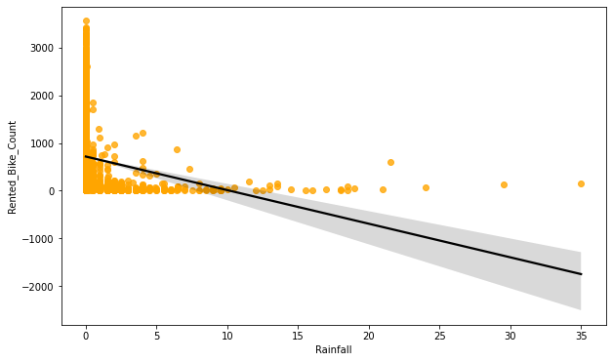
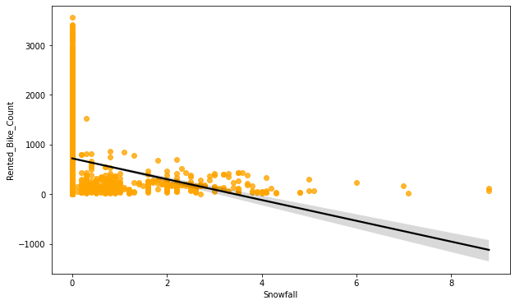
REGRESSION PLOT FOR NUMERICAL VARIABLE

Slide 19
REGRESSION PLOT FOR NUMERICAL VARIABLE
➢ From the above regression plot of all numerical features we see that the columns 'Temperature', 'Wind_speed','Visibility', 'Dew_point_temperature', 'Solar_Radiation' are positively relation to the target variable which means the rented bike count increases with increase of these features.
➢ 'Rainfall‘ , 'Snowfall', 'Humidity' these features are negatively related with the target variable which means the rented bike count decreases when these features increase.

Slide 20
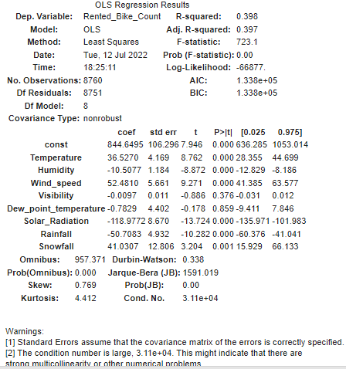
OLS REGRESSION MODEL
➢ R square and Adj. R-Squared are near to each other. 40% of variance in the Rented Bike count is explained by the model.
➢ P value of dew point temp and visibility are very high and they are not significant.

Slide 21
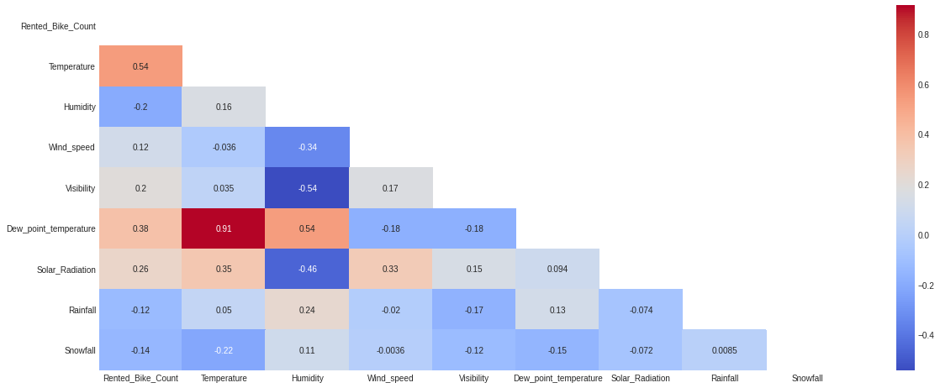
CORRELATION MATRIX
➢ Variables like Dew Point Temperature, and Temperature are highly correlated.

Slide 22
MODEL BUILDING
➢ LINEAR REGRESSION.
➢ LASSO REGRESSION.
➢ RIDGE REGRESSION.
➢ DECISION TREES REGRESSOR.
➢ RANDOM FOREST REGRESSOR.
➢ GRADIENT BOOSTED REGRESSOR.
➢ GRADIENT BOOSTING REGRESSOR WITH GRID SEARCH CV.

Slide 23
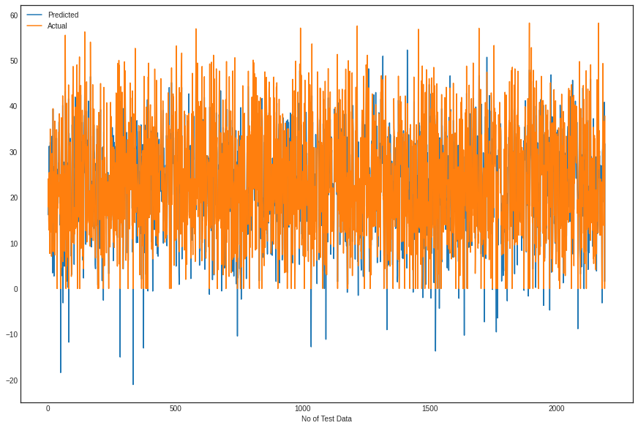
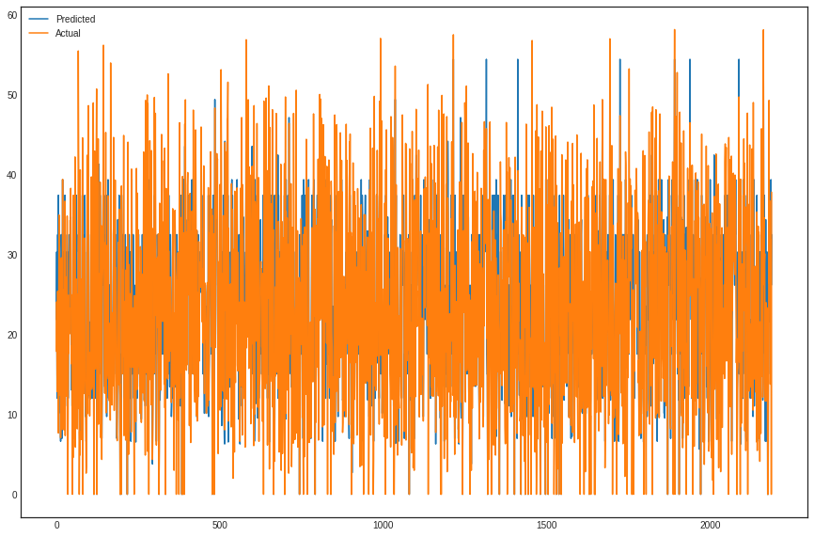
LINEAR REGRESSION
DECISION TREE
Train Set Results
Test Set Results
Train Set Results
Test Set Results
MSE : 35.07751288189293
RMSE : 5.9226271942350825
MAE : 4.474024092996787
R2 : 0.7722101548255267
Adjusted R2 : 0.7672119649454145
MSE : 33.27533089591926
RMSE : 5.76847734639907
MAE : 4.410178475318181
R2 : 0.7893518482962683
Adjusted R2 : 0.7847297833429184
MSE : 66.90586182077016
RMSE : 8.179600346029758
MAE : 5.990404702213558
R2 : 0.5764551170122585
Adjusted R2 : 0.5671616485246657
Model Score: 0.6289998290459555
MSE : 57.130568159687776
RMSE : 7.558476576644779
MAE : 5.61362639562623
R2 : 0.6289998290459555
Adjusted R2 : 0.6208593024190461

Slide 24
LASSO REGRESSION
RIDGE REGRESSION
ELASTIC NET REGRESSION
Train Set Results
Train Set Results
Train Set Results
MSE : 91.59423336097032
RMSE : 9.570487623991283
MAE : 7.255041571454952
R2 : 0.40519624904934015
Adjusted R2 : 0.3921449996120475
MSE : 35.07752456136463
RMSE : 5.922628180239296
MAE : 4.474125776125378
R2 : 0.7722100789802107
Adjusted R2 : 0.7672118874358922
MSE : 57.5742035398887
RMSE : 7.587766703048315
MAE : 5.792276538970546
R2 : 0.6261189054494012
Adjusted R2 : 0.6179151652795234
Test Set Results
Test Set Results
Test Set Results
MSE : 96.7750714044618
RMSE : 9.837432155011886
MAE : 7.455895061963607
R2 : 0.3873692800799008
Adjusted R2 : 0.37392686932535146
MSE : 33.27678426818438
RMSE : 5.768603320404722
MAE : 4.410414932539515
R2 : 0.7893426477812578
Adjusted R2 : 0.7847203809491939
MSE : 59.45120536350042
RMSE : 7.710460775044538
MAE : 5.873612334800099
R2 : 0.6236465216363589
Adjusted R2 : 0.6153885321484546

Slide 25
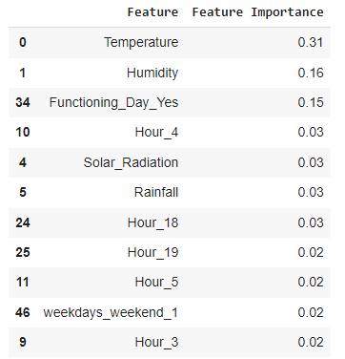
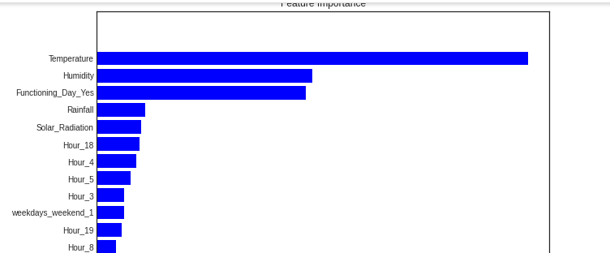
RANDOM FOREST
Train Set Results
Model Score: 0.9897470110268578
MSE : 1.5788647316908788
RMSE : 1.2565288423633096
MAE : 0.8041831165097016
R2 : 0.9897470110268578
Adjusted R2 : 0.9895220388131614
Test Set Results
MSE : 12.66885348135942
RMSE : 3.5593332916937435
MAE : 2.2153375458817877
R2 : 0.9198003296075105
Adjusted R2 : 0.918040579603567

Slide 26
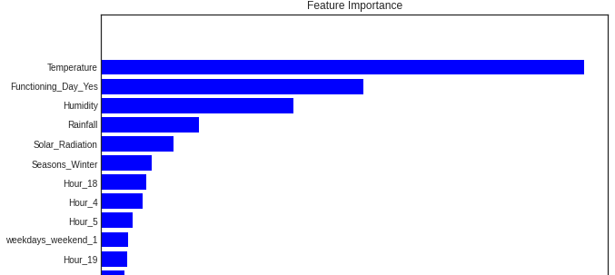
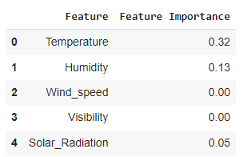
GRADIENT BOOSTING
Train Set Results
Model Score: 0.8789016499095264
MSE : 18.64801713184794
RMSE : 4.3183349953249275
MAE : 3.2690035692731247
R2 : 0.8789016499095264
Adjusted R2 : 0.8762444965695393
Test Set Results
MSE : 21.28944184250869
RMSE : 4.6140483138463875
MAE : 3.492858786559991
R2 : 0.8652280396863458
Adjusted R2 : 0.8622708584843188

Slide 27
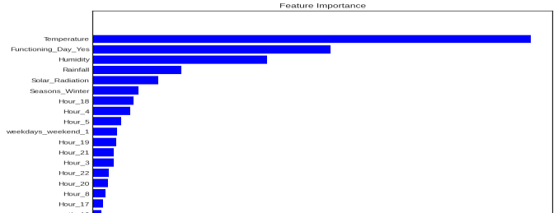
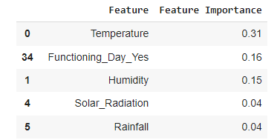
GRADIENT BOOSTING REGRESSOR WITH GRIDSEARCH CV
Train Set Results
Model Score: 0.9515896672300013
MSE : 7.454740004128373
RMSE : 2.7303369762958516
MAE : 1.8489194833919358
R2 : 0.9515896672300013
Adjusted R2 : 0.9505274423746372
Test Set Results
MSE : 12.392760556291105
RMSE : 3.520335290322657
MAE : 2.4005915565405354
R2 : 0.921548124829924
Adjusted R2 : 0.9198267251413182
Hyper parameter
{'max_depth': 8,
'min_samples_leaf': 40,
'min_samples_split': 50,
'n_estimators': 100}

Slide 28
CHALLENGES
Large Dataset to handle.
Needs to plot lot of Graphs to analyze.
Feature engineering.
Feature selection.
Optimising the model.
Carefully tuned Hyper parameters as it affects the R2 score.

Slide 29
CONCLUSION
‘Hour’ of the day holds the most important feature.
Bike rental count is mostly correlated with the time of the day as it is peak at 10 am morning and 8 pm at evening.
We observed that bike rental count is high during working days than non working day.
We see that people generally prefer to bike at moderate to high temperatures, and when little windy.
It is observed that highest number bike rentals counts in Autumn & Summer seasons & the lowest in winter season. We observed that the highest number of bike rentals on a clear day and the lowest on a snowy or rainy day. We observed that with increasing humidity, the number of bike rental counts decreases.

Slide 30
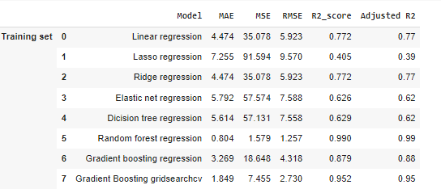
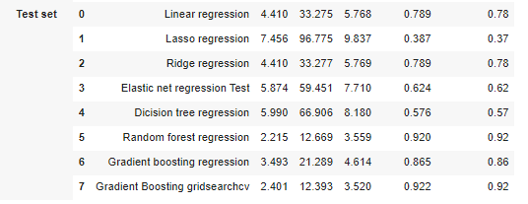
CONCLUSION
When we compare the root mean squared error and mean absolute error of all the models, Random forest Regressor and Gradient Boosting grid search cv gives the highest R2 score of 99% and 95% respectively for Train Set and 92% for Test set. So, finally this model is best for predicting the bike rental count on daily basis.

Slide 31


